Slide 1


PANCHVATI VALVES
&
FLANGES PVT. LTD.
Engineering Flow Control Solutions for a Better Tomorrow
📍 India | 🌐 www.panchvativalveS.com
📧 info@panchvativalve.com, panchvativalves@gmail.com

Slide 2
COMPANY OVERVIEW
Panchvati Valves & Flanges Pvt. Ltd., established in 1991, is a trusted Indian manufacturer of Cast Steel and Forged Steel Gate, Globe, and Check Valves. With over three decades of excellence, we serve critical sectors like Oil & Gas and Power, delivering high-performance valves designed for extreme conditions including cryogenic temperatures, high pressures, and corrosive media.
Our products are exported to global markets such as the USA, Spain, Poland, Mexico, Saudi Arabia, and Nigeria, and are routinely inspected by renowned international agencies like BV, DNV, EIL, Lloyds, and TUV. As an ISO 9001:2015 certified company, Panchvati Valves is committed to world-class quality and reliability, ensuring each product meets or exceeds international standards.

Slide 3
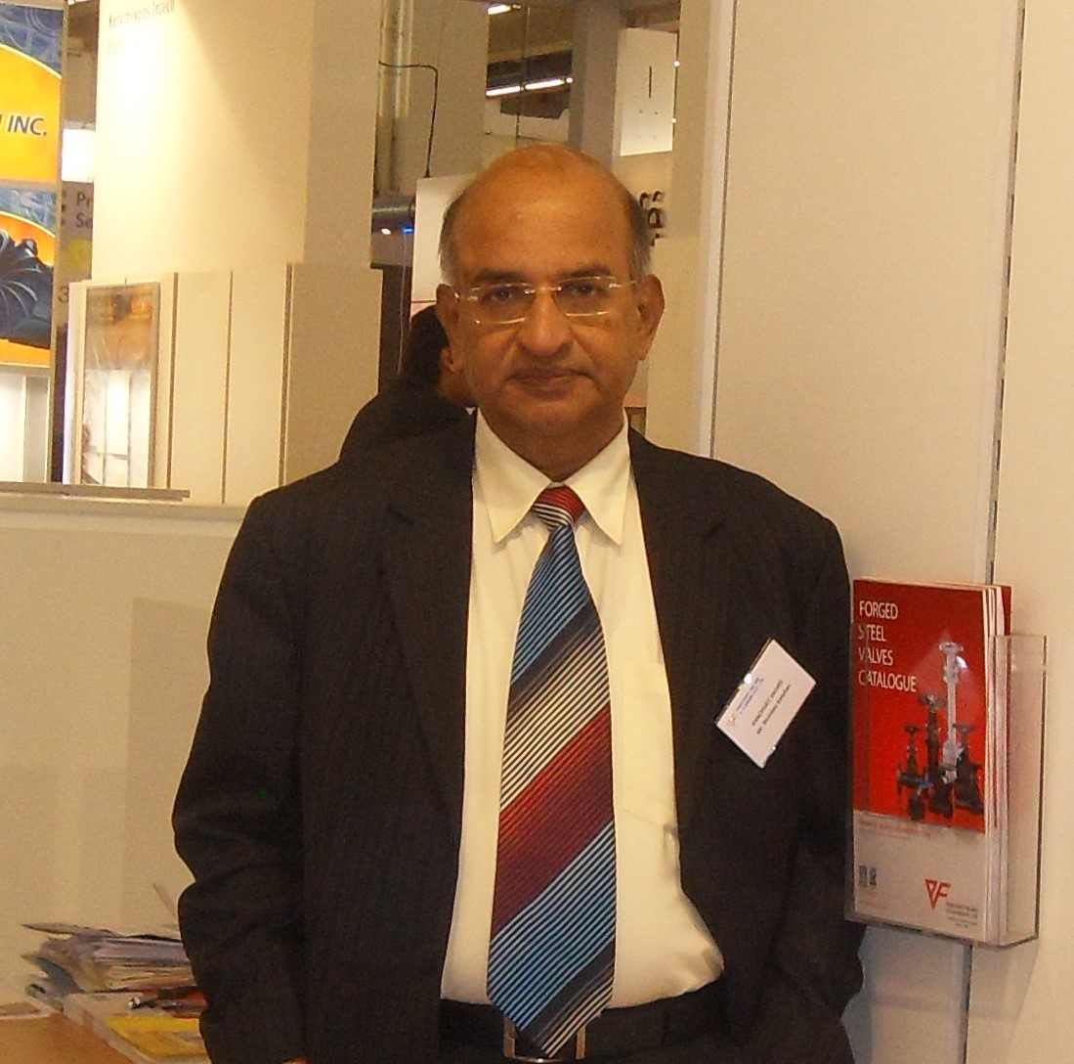
OUR FOUNDER
Shri Shrinivas Narayan Kanchan (1 March 1948 – 1 February 2025) was the visionary founder of Panchvati Valves & Flanges Pvt. Ltd., whose life embodied determination, integrity, and service to the nation. From humble beginnings in Muloor, Mangalore, to building one of India’s most respected valve manufacturing companies, his journey was marked by deep technical acumen and an unshakeable commitment to quality. A mentor and leader, he nurtured a people-first culture and championed the Make in India movement with pride. In recognition of his extraordinary contributions to the industry, he was honored with the Rashtriya Nirman Ratan Award by the Government of India in 2022 — a moment of immense pride for him and for the entire Panchvati family. His legacy lives on — in every product we create, every market we serve, and every value we uphold.

Slide 4
VISION & MISSION
Our Vision: To be a global leader in flow control solutions through innovation, quality, and customer satisfaction.
Our Mission:
• Deliver high-performance, reliable valve and flange products
• Promote safety, sustainability & engineering excellence
• Foster long-term partnerships with clients globally

Slide 5
PRODUCT PORTFOLIO
Comprehensive Range of Products:
✔ Cast Steel Valves (Gate, Globe, Check)
✔ Forged Steel Valves (Gate, Globe, Check)
✔ Dual Plate, Swing & Lift Check Valves
✔ Ball Valves (Trunnion, Floating)
✔ Cryogenic & High-Temperature Valves

Slide 6
MATERIALS & STANDARDS
Materials Handled:
- Carbon Steel, Stainless Steel, Alloy Steel, Duplex, Super Duplex
- Inconel, Monel, Hastelloy, Alloy 20, Bronze, Titanium
Compliance & Standards:
- API 6D, API 600, API 602, API 598
- ASME B16.34, BS 1873, BS 1868, BS 6755

Slide 7
INDUSTRIES WE SERVE
Diverse Industry Applications:
🔹 Oil & Gas
🔹 Petrochemicals & Refineries
🔹 Power Generation
🔹 Fertilizers Industries
🔹 Marine & Offshore
🔹 Chemical Industries

Slide 8
GLOBAL REACH
Exporting to Countries:-
- USA, Africa, Middle East, Europe
- Participation in global exhibitions like Valve World - Germany, ACHEMA - Germany, OTC – Houston, USA.
- Government-approved vendor across multiple regions

Slide 9
MANUFACTURING CAPABILITIES
Advanced Infrastructure:
- CNC Machining, In-house Testing Facilities
- Sand Casting, Forging & Heat Treatment Facilities
- In-house QA/QC team & hydro testing up to 15,000 psi
- Large stockholding capacity for urgent requirements

Slide 10
CERTIFICATIONS
Quality Assurance:
- ISO 9001:2015 Certified
- ISO 45001:2018 Certified
- EIL Certified
- IBR Certification
- Other Certifications (upon request)

Slide 11
Why Choose Us?
Key Differentiators:
✅ Decades of engineering expertise
✅ High-performance, tested products
✅ Custom design capabilities
✅ Competitive pricing
✅ Rapid delivery timelines
✅ Global support and service

Slide 12










NATIONAL CLIENTS
Trusted By Leading Companies:

Slide 13










NATIONAL CLIENTS
Trusted By Leading Companies:

Slide 14










NATIONAL CLIENTS
Trusted By Leading Companies:

Slide 15







INTERNATIONAL CLIENTS

Slide 16
Get in Touch
Panchvati Valves & Flanges Pvt. Ltd.
📍 HEAD OFFICE – MUMBAI
Sumit Samarth Arcade, 'B' Wing,
5th Floor, 503, A & B, Behind Jain Mandir
Aarey Road, Goregaon (W), Mumbai - 400 104
📧 info@panchvativalve.com , 📧 panchvativalves@gmail.com
🌐 www.panchvativalve.com
📞 +919821275695
🔗 Follow us: LinkedIn

